Slide 1


Slide 2






Nissa Amelia Pahlevy
Chief Executive Officer
Bagus Avianto Putra
Chief of Creative Design
and Marketing
Irfan Haris
Chief of Research
Fury Oktria Putra
Chief of Production
Nindya Dini P
Chief of Financial
Officer
UNIVERSITAS
GADJAH
MADA

Slide 3

OUR VISION
OUR
BUSINESS
SOCIAL
PROFIT
EFFECT

Slide 4


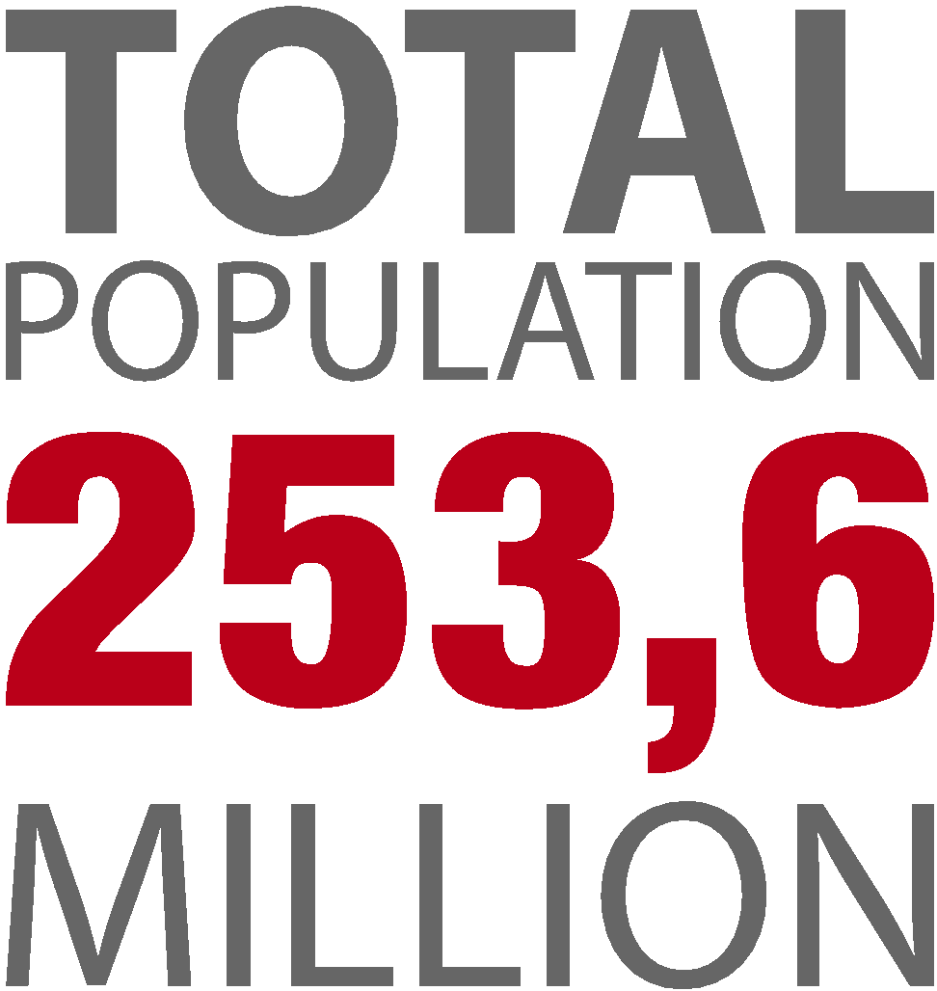


BADAN PUSAT STATISTIK

Slide 5

BUT?
THERE ARE
MANY PROBLEMS

Slide 6





Survei Demografi Kesehatan Indonesia (SDKI), 2007

Slide 7




ANEMIA
40.1%
41.0%
CHRONIC ENERGY DEFICIENCY
THE TOP
PROBLEM
DEPRESSION
BY PREGNANT MOM
33.9%

Slide 8
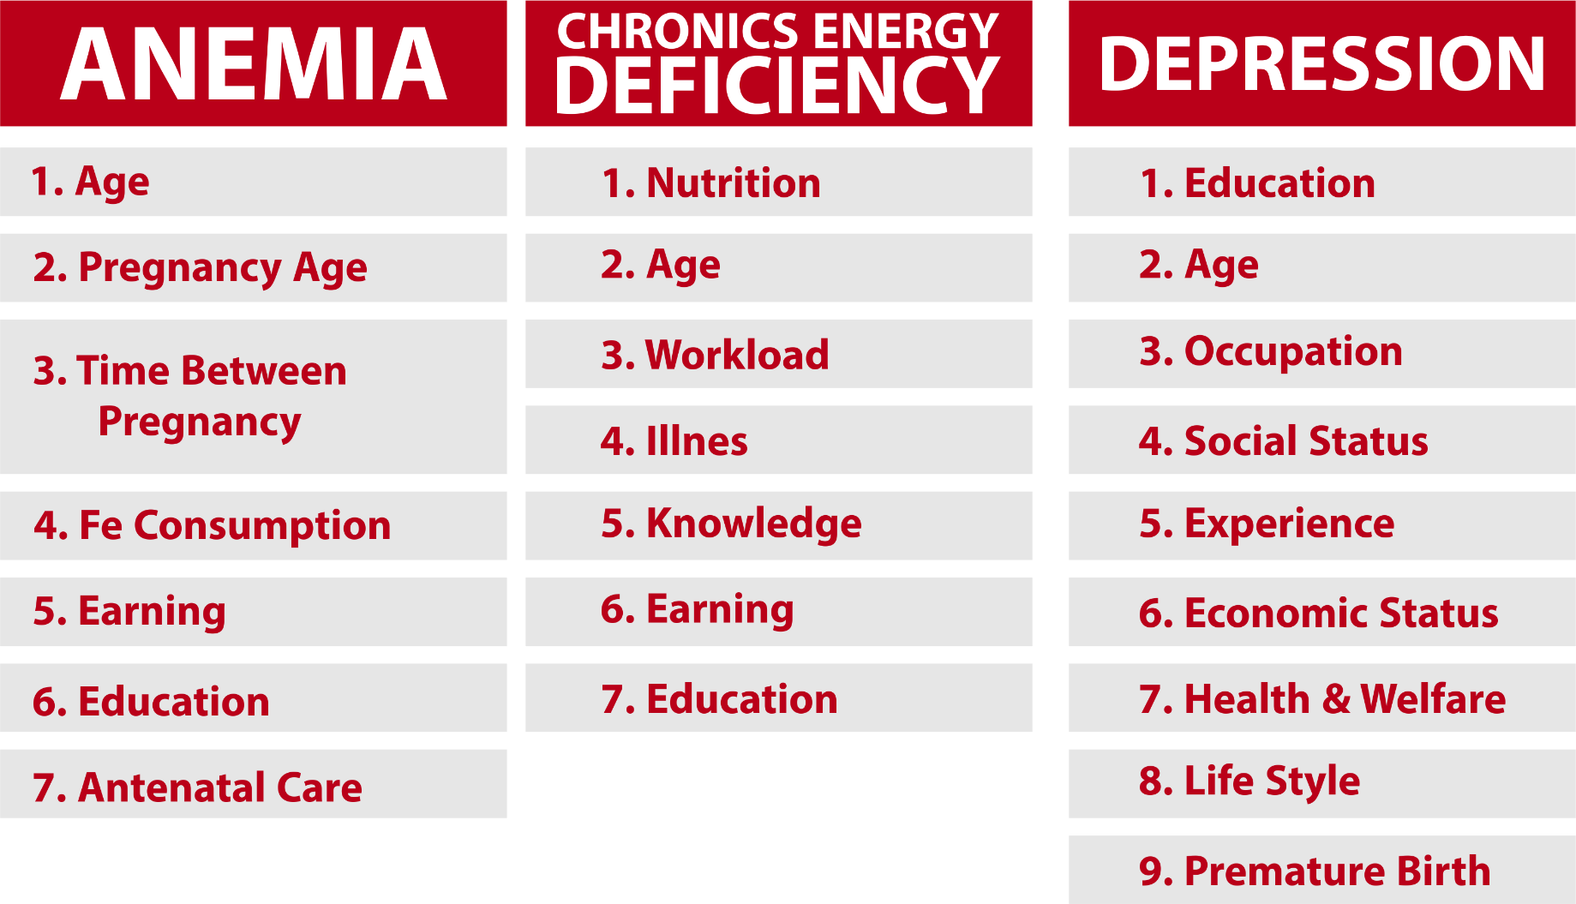
FACTORS
SKRT, 2014
Depkes RI, 2013
Widayanti, 2013

Slide 9

EDUCATION
Education may have both a direct and indirect relationship with maternal mortality. It is affect mother’s health during pregnancy. Increasing levels of educational attainment are likely to enhance the capacity of women to obtain, process and understand basic health information about the benefits of good prenatal care and the reproductive health services needed to make appropriate health decisions
Karlsen et al., 2011

Slide 10
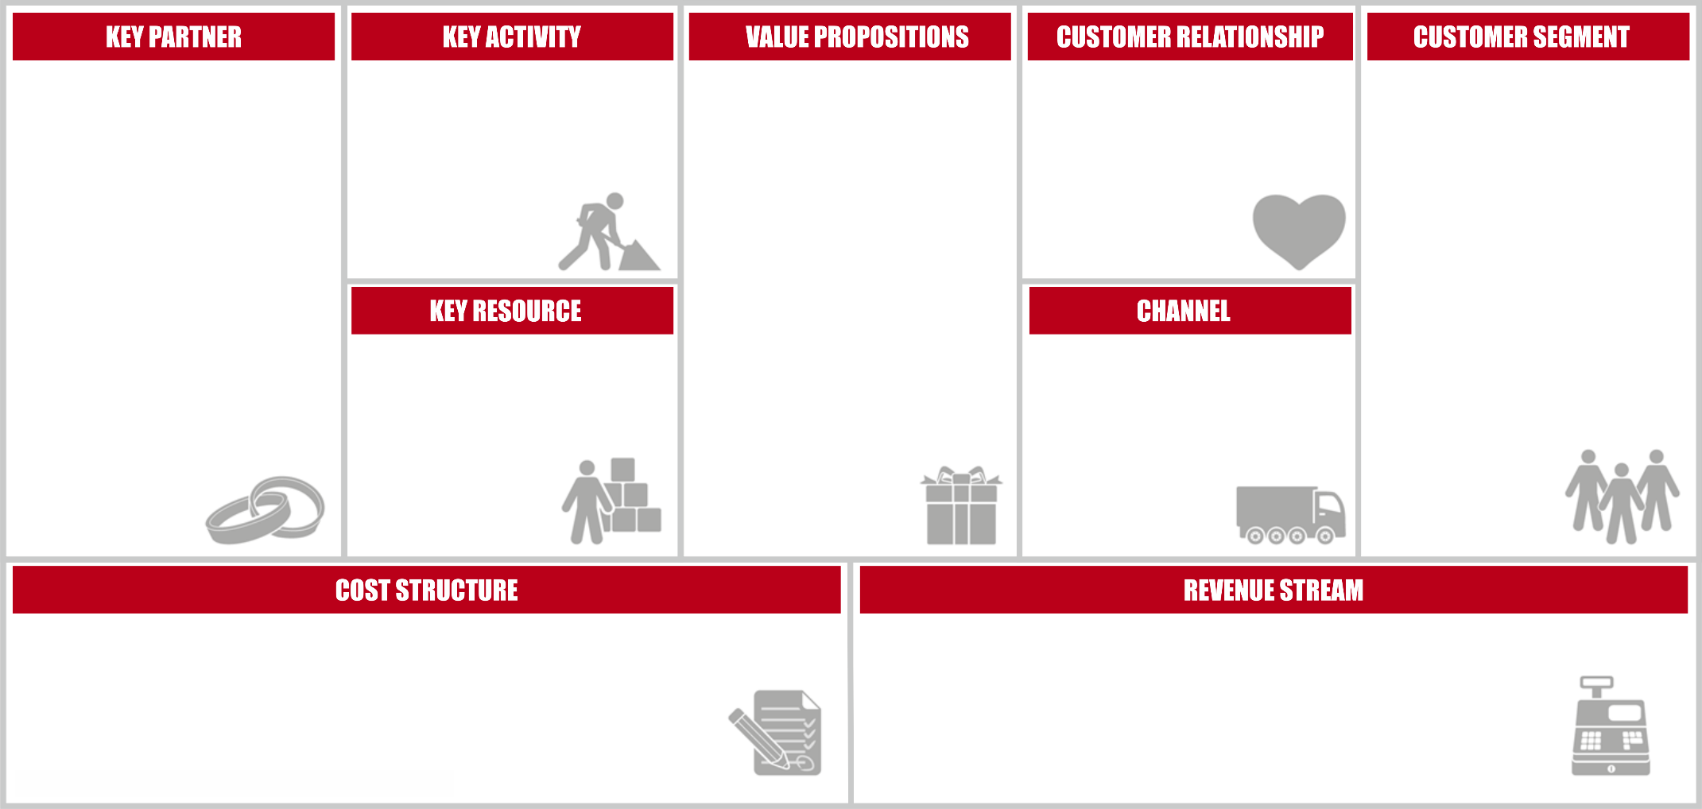

PIVOT
Tool which provides information for pregnant mom about their activity
PREGNANT
MOM
Research &
Development
R&D Staff

Slide 11

HYPOTHESES

Slide 12


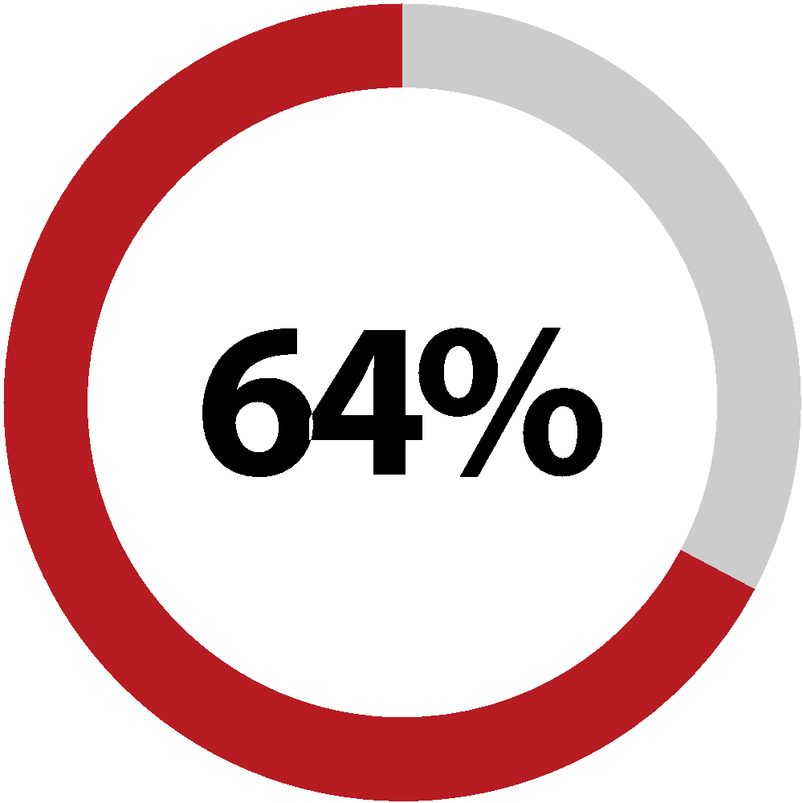


ACTION
FROM 100 RESPONDENTS
Pregnant moms need to know their health condition
Pregnant moms have complaints during pregnancy
Pregnant moms never record their medical history
Pregnant moms should record their medical history

Slide 13

CONCLUSION
YES!

Slide 14




PIVOT
Research &
Development
Tool which provides information for pregnant mom about their activity
PREGNANT
MOM
R&D Staff
OBSTETRICIANS
Giving Medical Record
Manufacturing of Products
Research and Development Costs
Staff Payment
PRODUCT SALES

Slide 15


PIVOT
VALUE
PROPOSITION
Not only giving informations but also REMINDING pregnant moms about their diet, exercise, and doctor visit schedule
Provide a direct ONLINE CONSULTATION

Slide 16




HYPOTHESES
FOOD
having differences in their dietary habit during pregnancy
REMINDER
do not have reminder and fix schedule about their diet, exercise and doctor visit
ONLINE
need fast information through mobile phone
DOCTOR
need real time consultation with doctor

Slide 17





ACTION
FROM 100 RESPONDENTS
Have differences in their dietary habit during pregnancy
There is main menu during pregnancy
Do not have fix eating and daily activities schedule
Need special reminder for daily activities
Need fast information through mobile phone
Need real time consultation with doctor

Slide 18
CONCLUSION
YES!

Slide 19
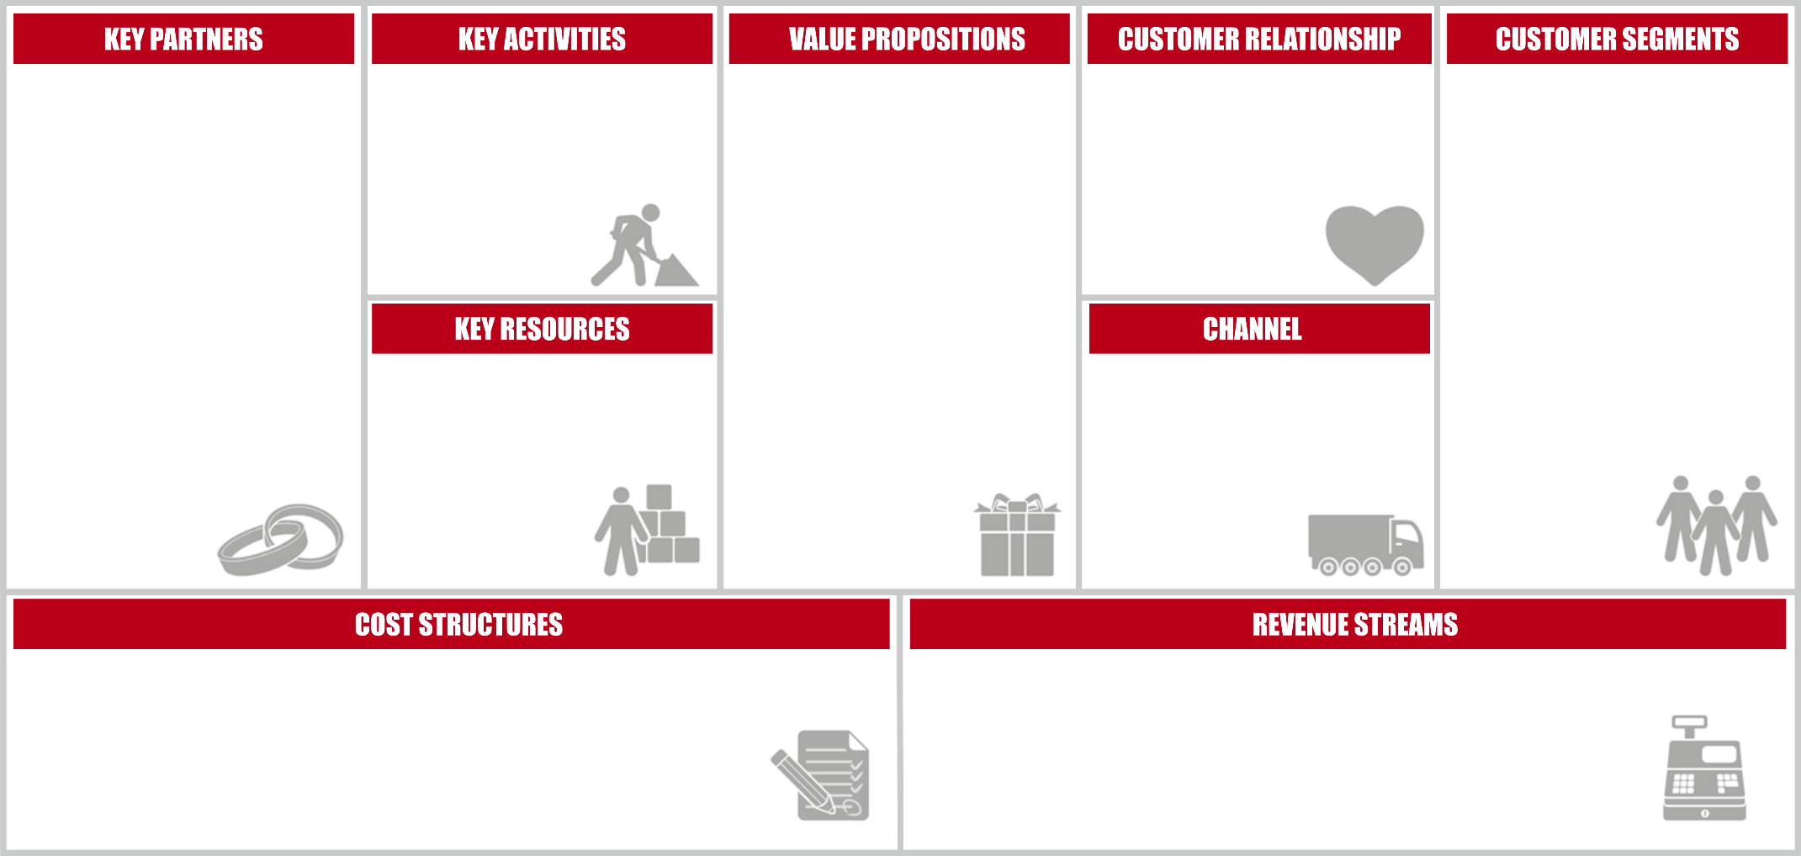
PIVOT
Research & Development
PREGNANT
OBSTETRICIANS
Tool which provides information for pregnant mom about their activity
MOM
Giving Medical Record
R&D Staff
Manufacturing of Products
Research and Development Costs
Staff Payment
PRODUCT SALES
APPLICATION SALES
ADVERTISER
NUTRITIONISTS
PRODUCE & SELL
FOOD
Advertising Space
FOODS & BAVERAGES SALES
Chef
MOBILE APPLICATION
which provides information for pregnant mom about their activity
ADVERTISING FEE
Chef
Raw Material
Maintenance cost
PREGNANT APPS
Reminder
Direct consultation with the doctor
PRODUCT
DISCOUNT
Provide food and
baverages for pregnant mom

Slide 20
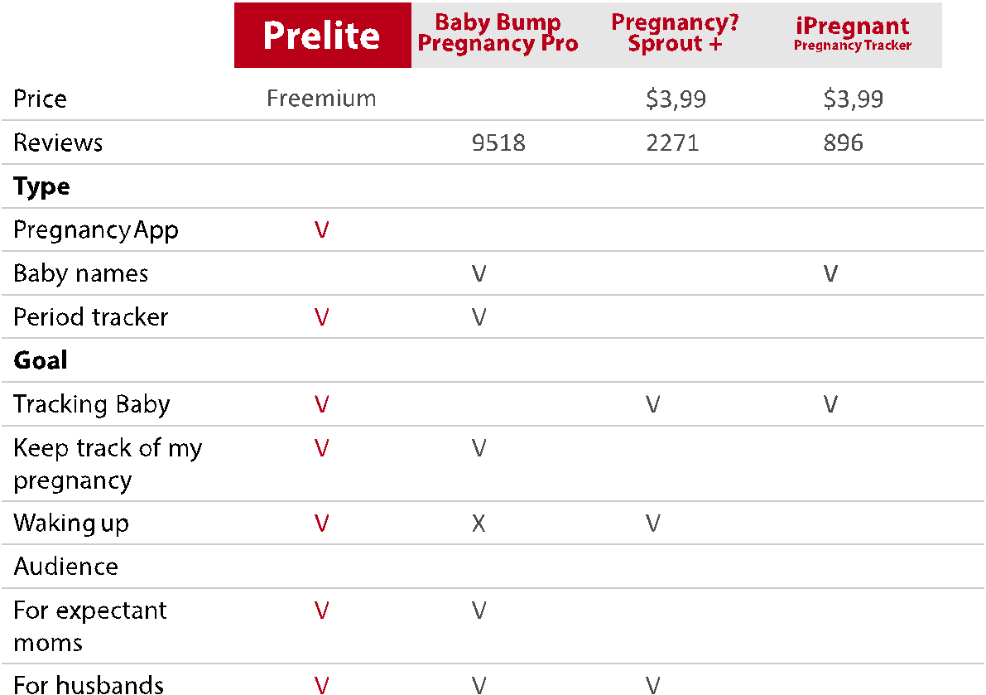
ACTION
BENCHMARKING
Our Apps

Slide 21

ACTION
BENCHMARKING
Our Apps

Slide 22

HYPOTHESES
CHANNEL
Pregnant moms know how to pay paid application

Slide 23

ACTION
FROM 100 RESPONDENTS
81%
Pregnant moms did not know
how to pay paid application

Slide 24

CONCLUSION
NO!

Slide 25
PIVOT
Research & Development
MOBILE APPLICATION
which provides information for pregnant mom about their activity
PRODUCT
DISCOUNT
PREGNANT
OBSTETRICIANS
MOM
NUTRITIONISTS
PRODUCE & SELL
FOOD
ADVERTISER
Giving Medical Record
Reminder
Direct consultation with the doctor
R&D Staff
PREGNANT APPS
Chef
Provide food and
baverages for pregnant mom
Advertising Space
APLICATION SALES
Chef
Raw Material
Maintenance cost
Manufacturing of Products
Research and Development Costs
Staff Payment
FOODS & BAVERAGES SALES
ADVERTISING FEE
Healthcare Personnel

Slide 26



Slide 27




Slide 28
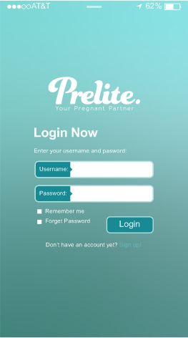
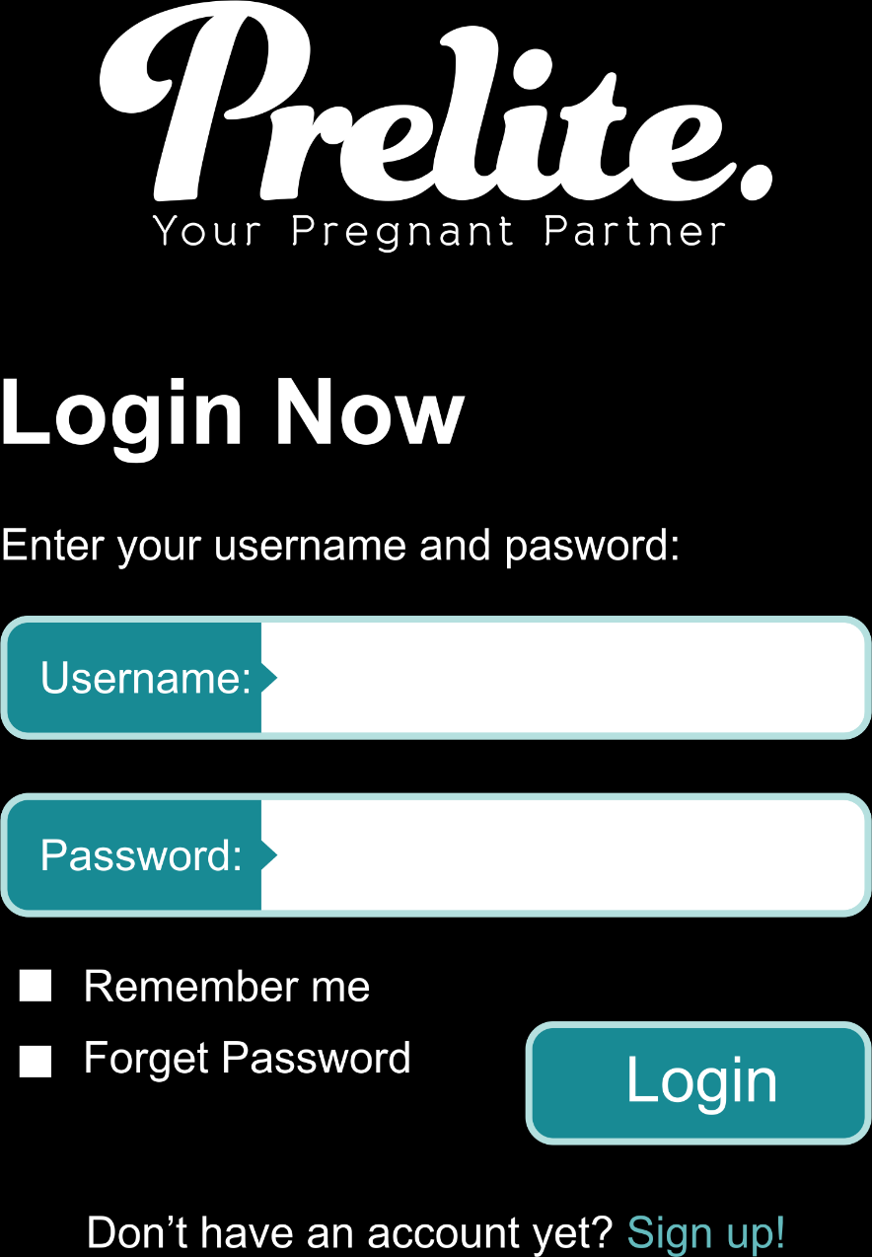
NISSAAMELIA
.............

Slide 29
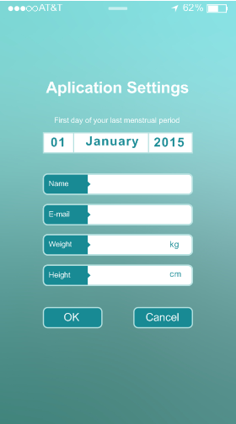
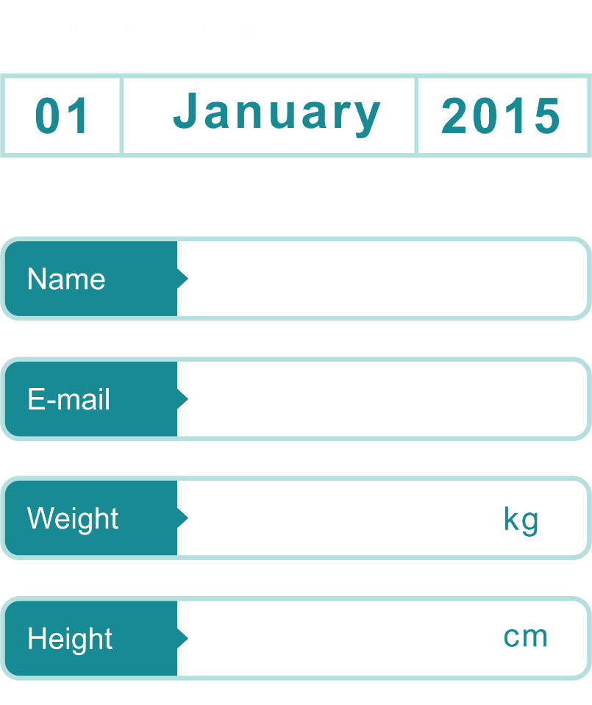
NISSA AMELIA PAHLEVY
nissaamelia@gmail.com
60
165

Slide 30
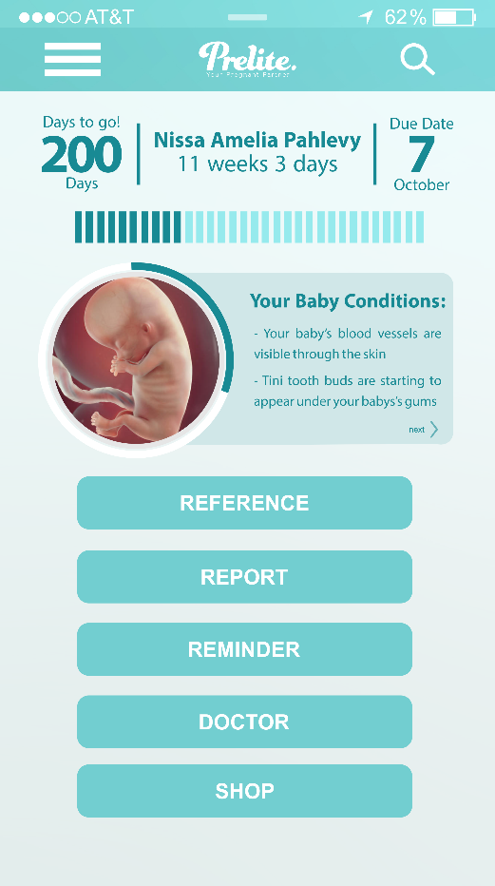


]
DAILY UPDATE INFORMATION
]
UPDATE CONDITION

Slide 31

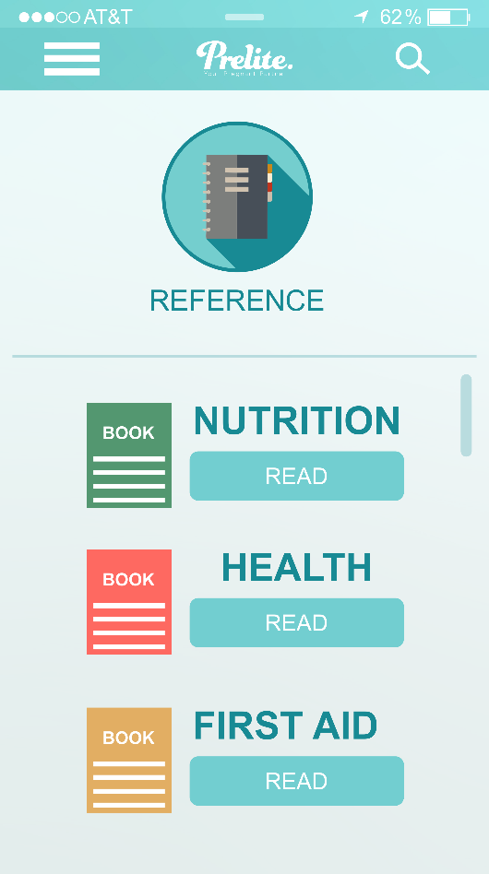

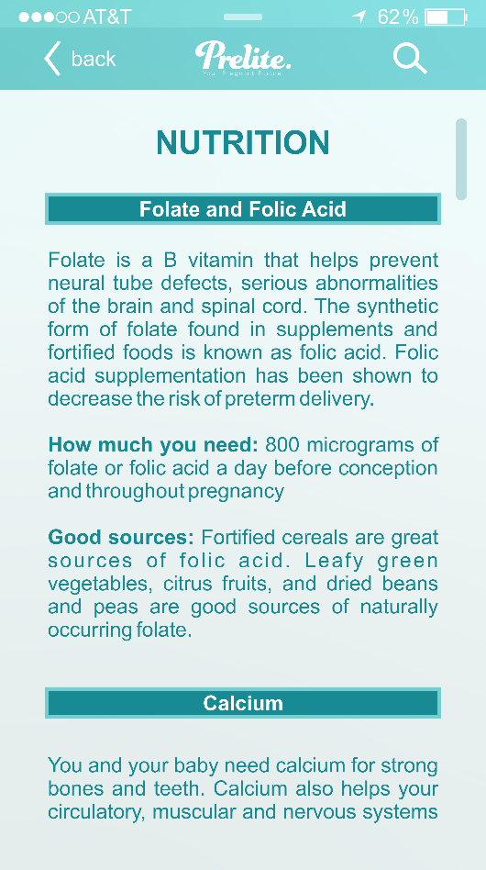
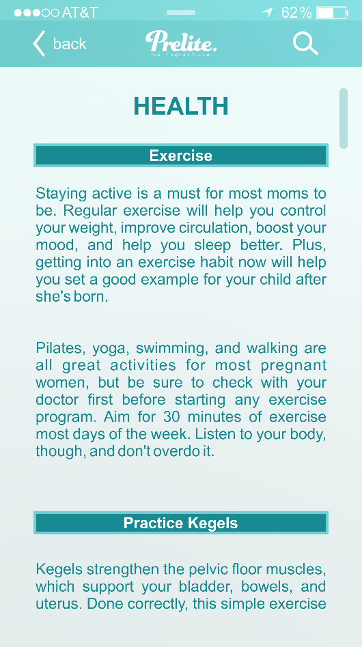
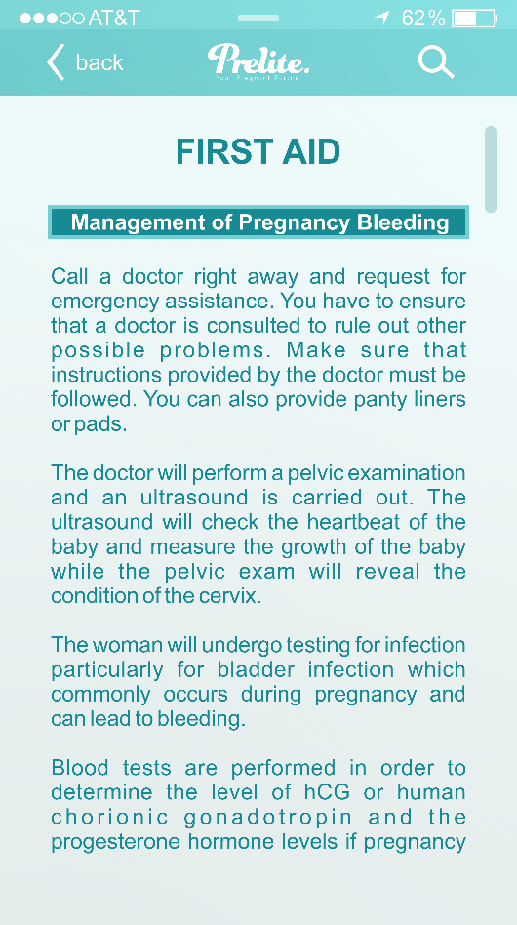

Slide 32

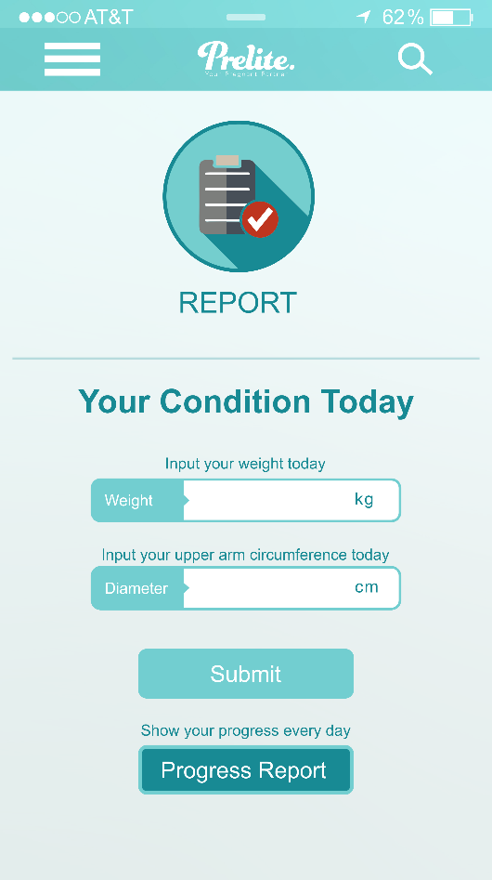
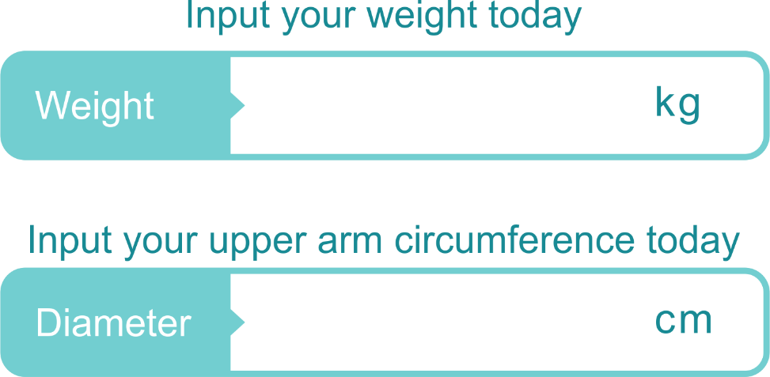
63
28,7

Slide 33
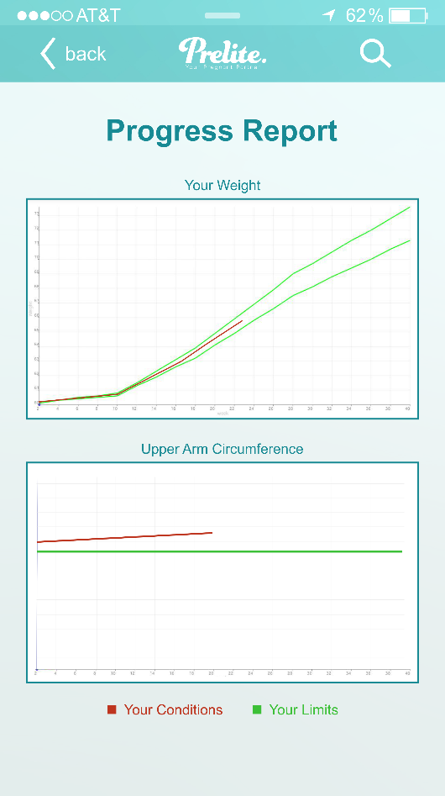


Slide 34
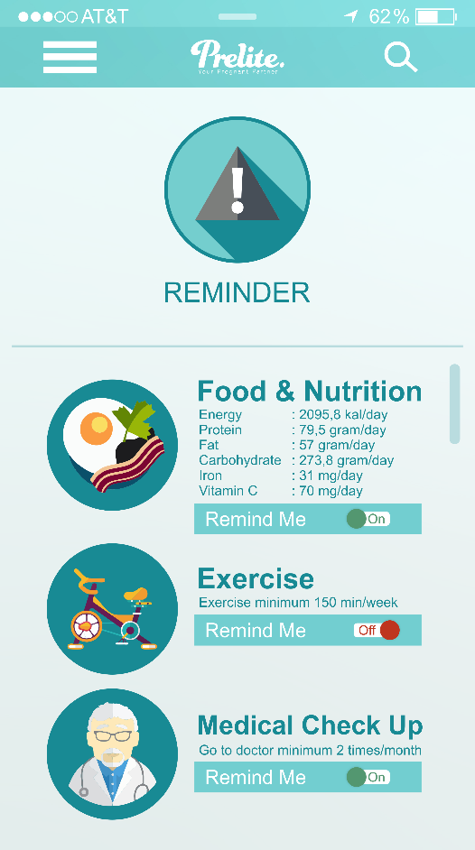




Slide 35

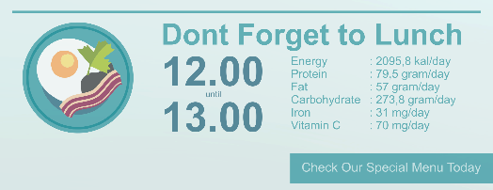




Slide 36

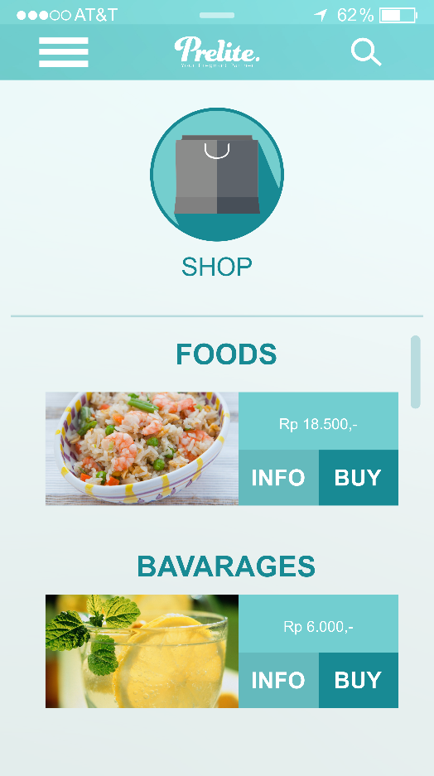



Slide 37
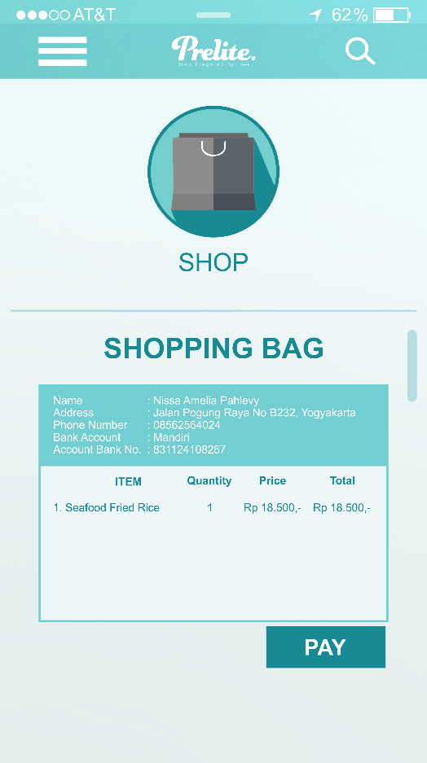


Slide 38




Slide 39
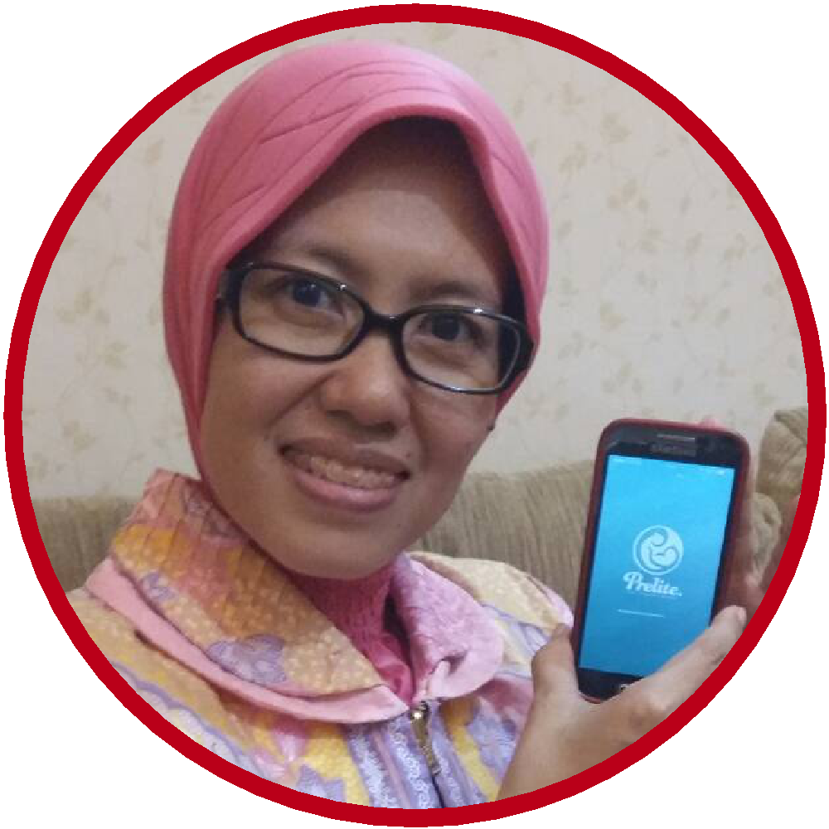

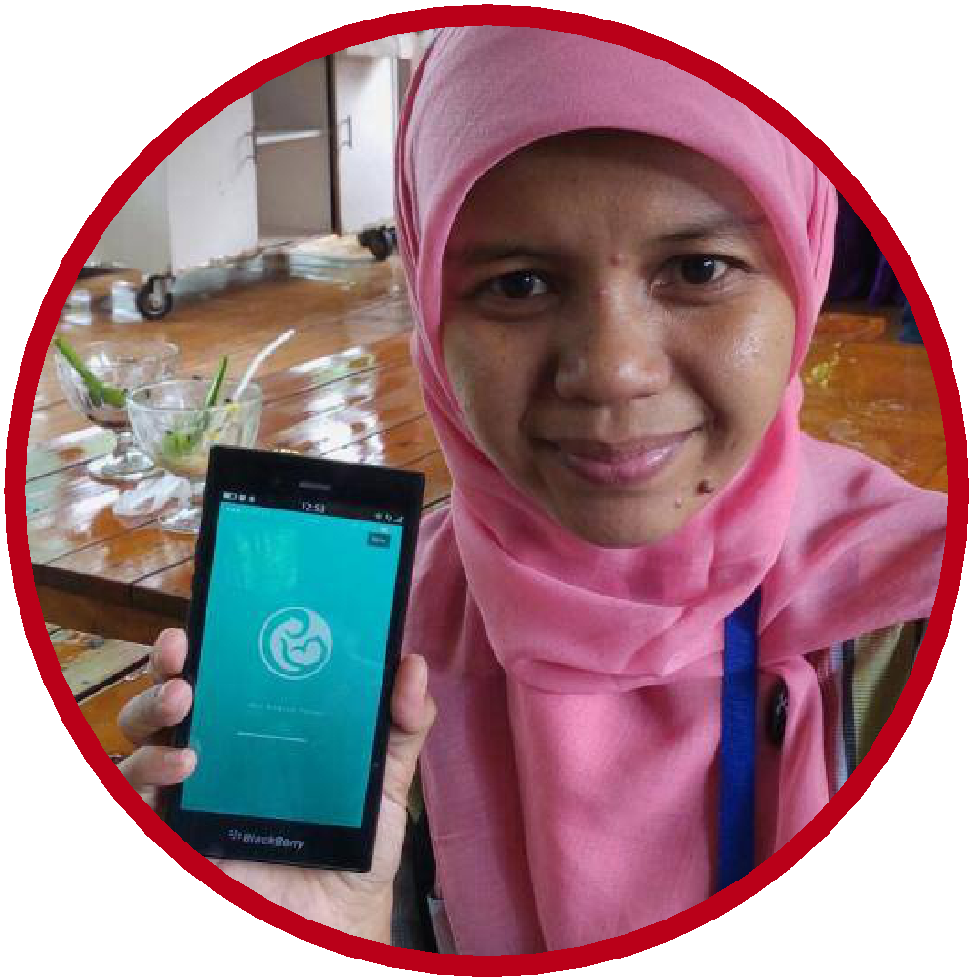
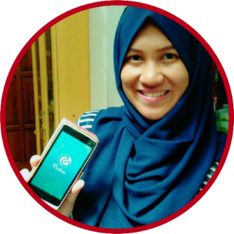
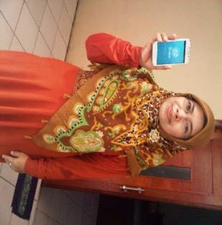
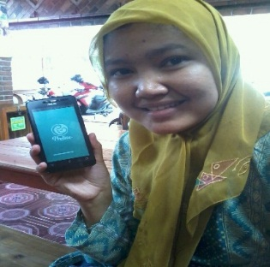
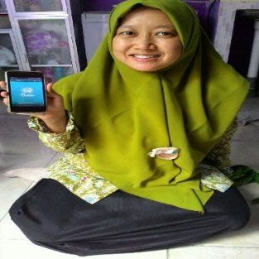
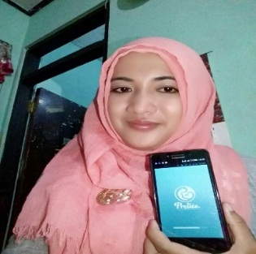
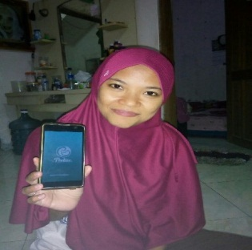
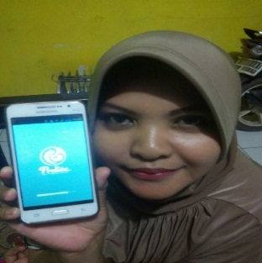
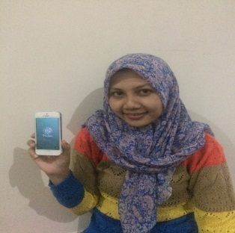
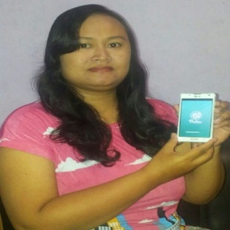
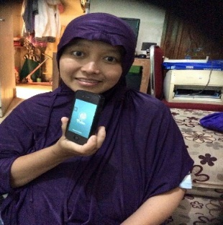
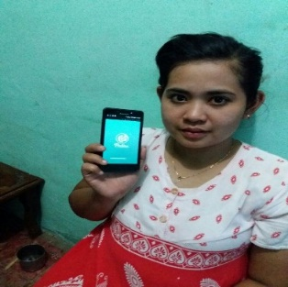
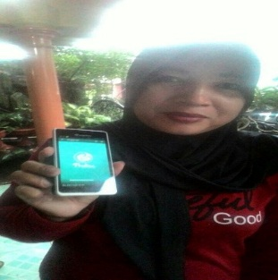
PRODUCT TESTING
COSTUMERS

Slide 40
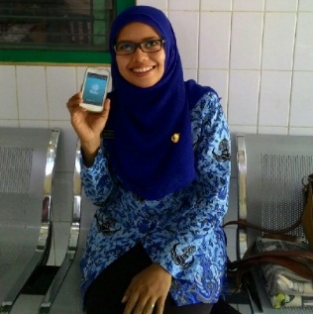
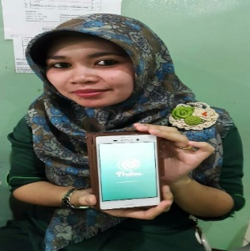
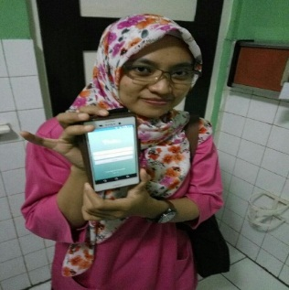
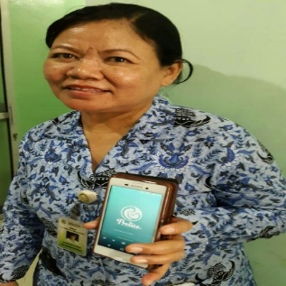
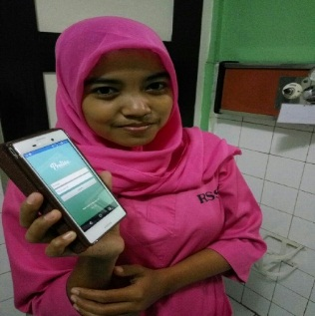
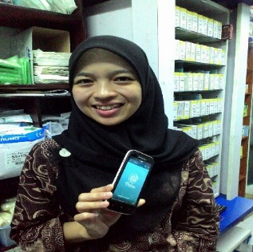
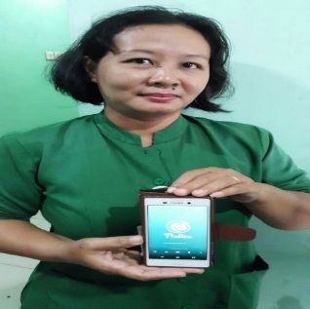


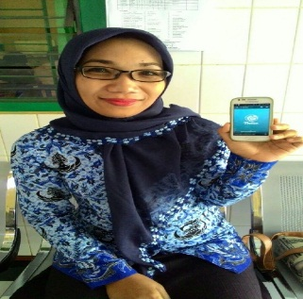
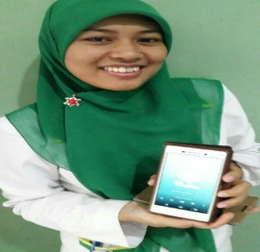
PRODUCT TESTING
HEALTHCARE PERSONNEL
INFORMATIVE
INTERESTING
USEFUL
HELPFUL

Slide 41

EXPERT
SAID
“
Prelite is a helpful application for pregnant mom controls her medical records during pregnancy . But it will be better if this application can integrate mom and doctor, not only for having real time consultation but also as a base for her examination in the doctor. So that the doctor can control his patient as well
”
dr. Muhammad Nurhadi Rahman, Sp.OG
Lecturer Department Obstetric and Gynecology,
Faculty of Medicine, Universitas Gadjah Mada
Obstrectian in Sardjito Hospital

Slide 42
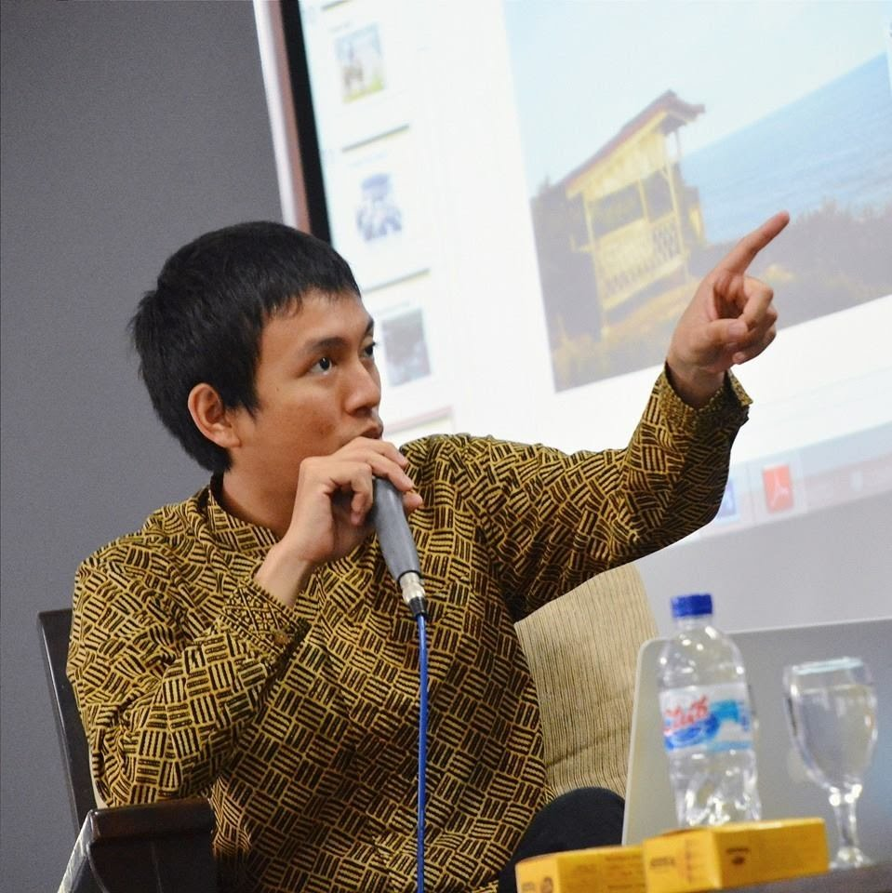
EXPERT
SAID
“
Prelite application has a good concept as start-up application. The idea for pregnant mom that can controls her medical records during pregnancy is very helpful. The display is very good looking and easy using for new user.
”
Gisneo Pratala Putra
CEO of Circus Studio Inc.
Developer Android and IOS Apps

Slide 43
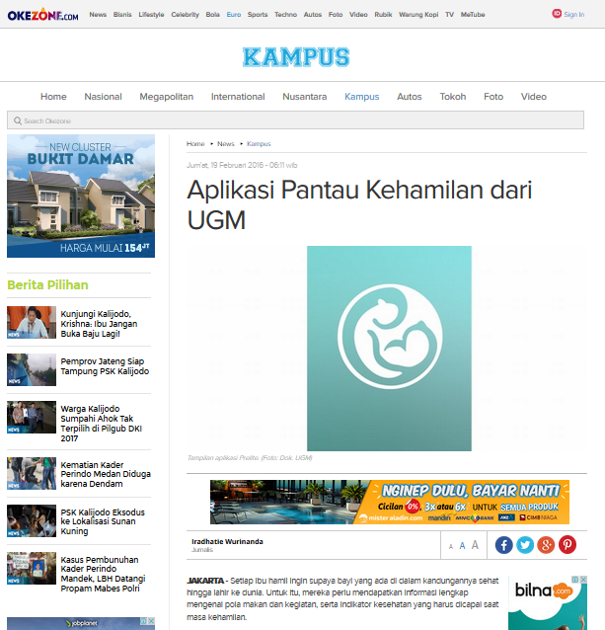
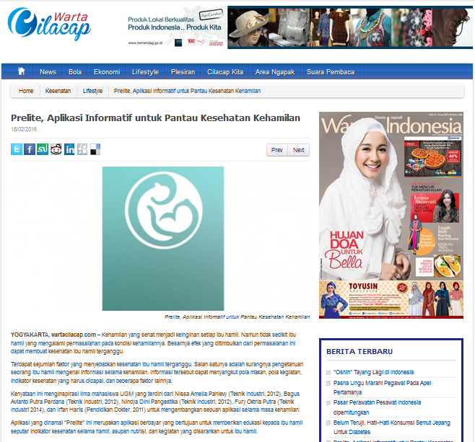
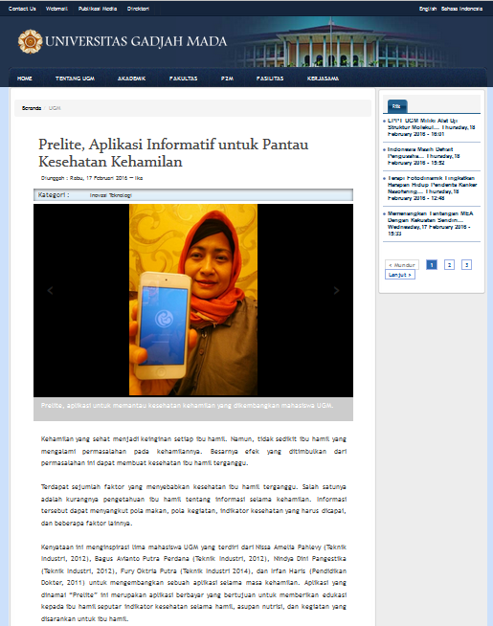
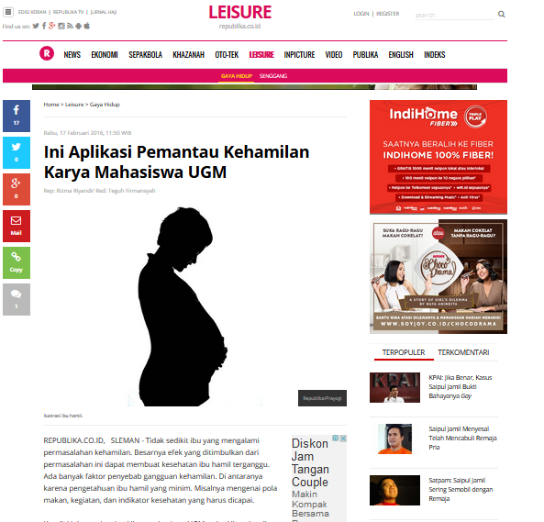




PUBLICATION

Slide 44

TOTAL VALIDATION
Action #1 : 100 Action #2 : 100 Action #3 : -
Action #4 : 100
Action #5 : 28
TOTAL : 328

Slide 45
PIVOT
Research & Development
MOBILE APPLICATION
which provides information for pregnant mom about their activity
PRODUCT
DISCOUNT
PREGNANT
OBSTETRICIANS
MOM
NUTRITIONISTS
PRODUCE & SELL
FOOD
ADVERTISER
Giving Medical Record
Reminder
Direct consultation with the doctor
R&D Staff
PREGNANT APPS
Chef
Provide food and
baverages for pregnant mom
Healthcare Personnel
Advertising Space
Manufacturing of Products
Research and Development Costs
Staff Payment
APLICATION SALES
FOODS & BAVERAGES SALES
Chef
Raw Material
Maintenance cost
ADVERTISING FEE
Multi Purpose
MOBILE APPLICATION
for pregnant mom
Data Sharing

Slide 46
BUSINESS PROGESS
Android App
developing
iOS App
developing
Food Production
ready to launch

Slide 47



Food Production
ready to launch

Slide 48


PRICE
PROMOTION
+
ONLINE
IDR 15.000
OFFLINE
Healthcare Personnel

Slide 49

OUR OFFICE
Jl. Flamboyan No.31, Depok, Sleman, Yogyakarta 55281

Slide 50





Slide 51




Slide 52
BUSINESS MODEL CANVAS
Research & Development
PRODUCT
DISCOUNT
PREGNANT
OBSTETRICIANS
Multi Purpose
MOBILE APPLICATION
for pregnant mom
MOM
NUTRITIONISTS
PRODUCE & SELL
FOOD
ADVERTISER
Data Sharing
R&D Staff
PREGNANT APPS
Chef
Healthcare Personnel
Manufacturing of Products
Research and Development Costs
Staff Payment
APLICATION SALES
FOODS & BAVERAGES SALES
Chef
Raw Material
Maintenance cost
ADVERTISING FEE

Slide 53

THANK YOU

